Slide 1
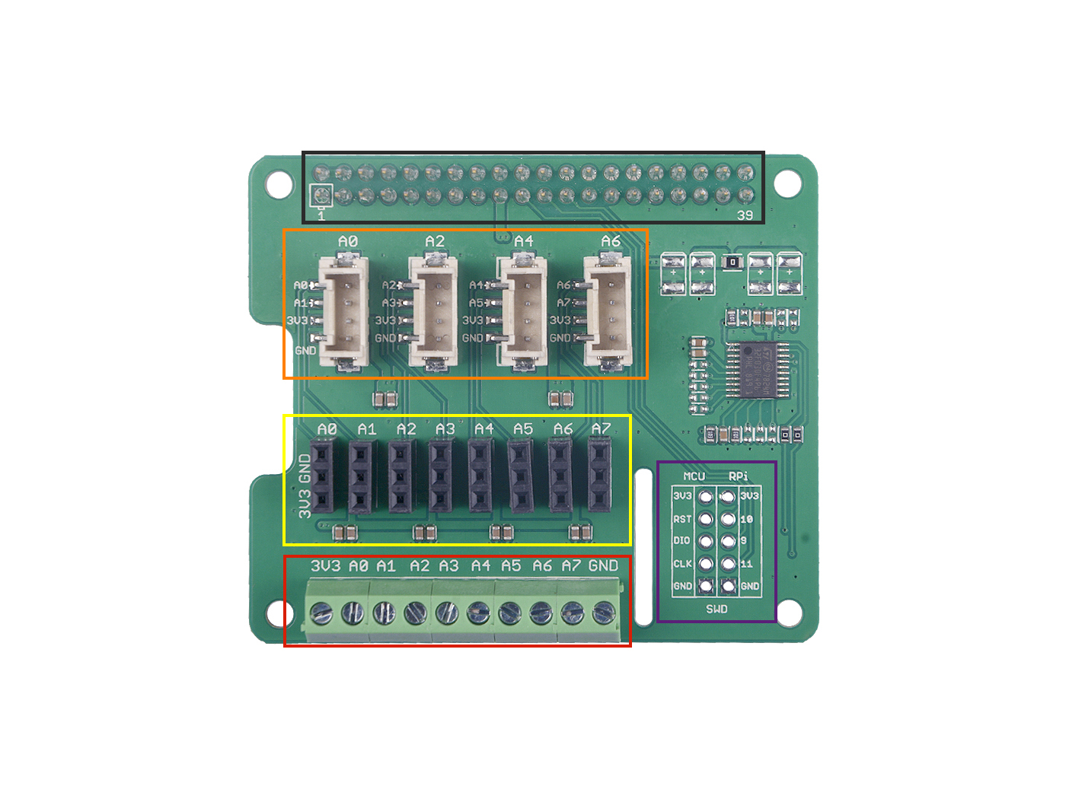
GPIO
Grove
analog port
Analog port
SWD
Analog
connecter

